Slide 1
EXECUTIVE SUMMARY REPORT ON
WEBSITE TRAFFIC DATASET
Oluwasola Arigbabowo
December 2020

Slide 2
BUSINESS GOAL
Collect data, transform, analyze, develop dashboard, provide key insights and recommendations to help Datatechon company make informed decisions on target audience demography, geographical location and overall website behavior between April 1- June 30th, 2020.
What are the best traffic sources to launch marketing campaigns based on performance?

Slide 3
DATA SOURCES
& TOOLS
The source for the database for the analysis are
Google Analytics
Datatechon database – DataAnalytics Consulting- All website data
= GoogleAnalytics.Accounts()
The data analytics tool used are:
Excel
Google Analytics
Power BI

Slide 4
KEY METRICS & DIMENSIONS
METRICS
New visitors – First time guest to the website
Returning visitors - Guests that have visited more than once
Bounce rate – rate at which guest arrives the site & immediately leaves the site
Page views- count of how many times a page has
been viewed
Avg time on page- Avg time spent by guests on the
website page
DIMENSION
Traffic Source
Traffic medium
Device category
Browser
Location- Country, region

Slide 5
METHODOLOGY
Extraction of dataset from Website via Google Analytics integrated in Power BI
Source = GoogleAnalytics.Accounts(),
#"159675043" = Source{[Id="159675043"]}[Data],
#"UA-159675043-1" = #"159675043"{[Id="UA-159675043-1"]}[Data],
#"212692353" = #"UA-159675043-1"{[Id="212692353"]}[Data],
#"Added Items" = Cube.Transform(#"212692353",
{{Cube.AddAndExpandDimensionColumn, "ga:country", {"ga:country"}, {"Country"}},
{Cube.AddAndExpandDimensionColumn, "ga:region", {"ga:region"}, {"Region"}},
{Cube.AddAndExpandDimensionColumn, "ga:browser", {"ga:browser"}, {"Browser"}},
{Cube.AddAndExpandDimensionColumn, "ga:deviceCategory", {"ga:deviceCategory"}, {"Device Category"}},
{Cube.AddAndExpandDimensionColumn, "ga:date", {"ga:date"}, {"Date"}},
{Cube.AddAndExpandDimensionColumn, "ga:sourceMedium", {"ga:sourceMedium"}, {"Source / Medium"}},
{Cube.AddMeasureColumn, "Avg. Time on Page", "ga:avgTimeOnPage"},
{Cube.AddMeasureColumn, "Pageviews", "ga:pageviews"},
{Cube.AddMeasureColumn, "Bounce Rate", "ga:bounceRate"},
{Cube.AddMeasureColumn, "New Users", "ga:newUsers"},
{Cube.AddMeasureColumn, "Users", "ga:users"}}),

Slide 6
METHODOLOGY
Data cleaning and transformation using Excel & Power BI
Column split by delimiter
=Table.SplitColumn(#"Capitalized Each Word", "Source / Medium", Splitter.SplitTextByDelimiter("/", QuoteStyle.Csv), {"Source / Medium.1", "Source / Medium.2"})
Filtered rows
= Table.SelectRows(#"Renamed Columns", each [Date] >= #date(2020, 4, 1) and [Date] <= #date(2020, 6, 30))
Sort rows
= Table.Sort(#"Filtered Rows",{{"Date", Order.Ascending}})
Transform Column
= Table.TransformColumns(#"Extracted Month Name1",{{"Avg. Time on Page", Duration.TotalS
econds, type number}})

Slide 7
METHODOLOGY
Data exploration by developing an interactive dashboard to identify key insights using Power BI
Visitors view – New & Returning visitors
Behavioral view- Bounce rate, Page view
Demography view – Country & region of visitors
Recommendation on best traffic sources to launch marketing campaigns

Slide 8
DATA EXPLORATION

Slide 9
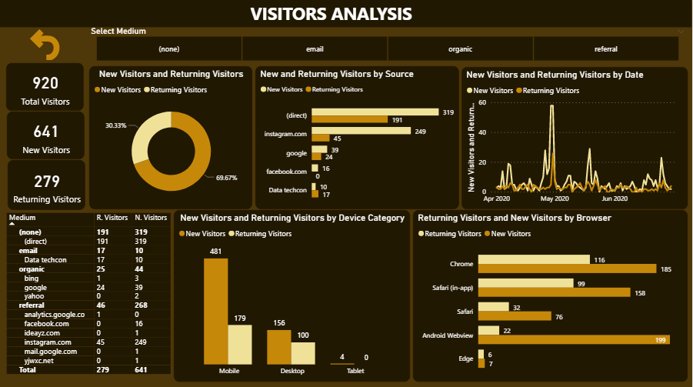

Slide 10

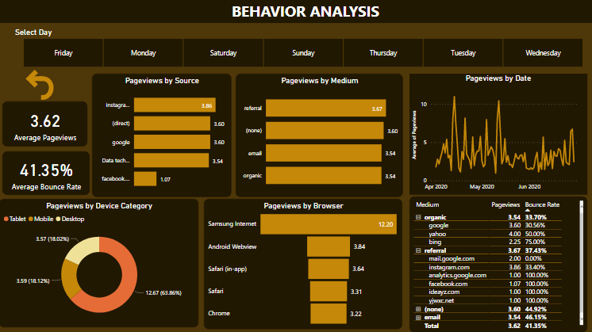

Slide 11
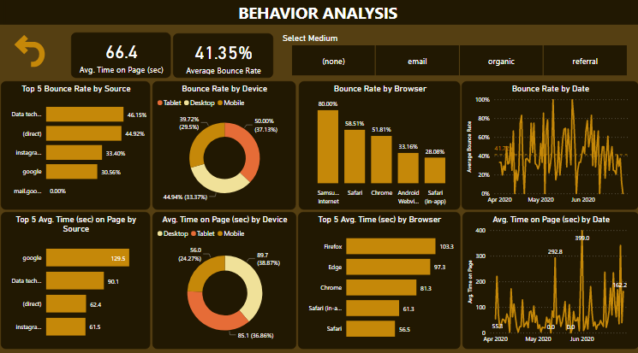

Slide 12
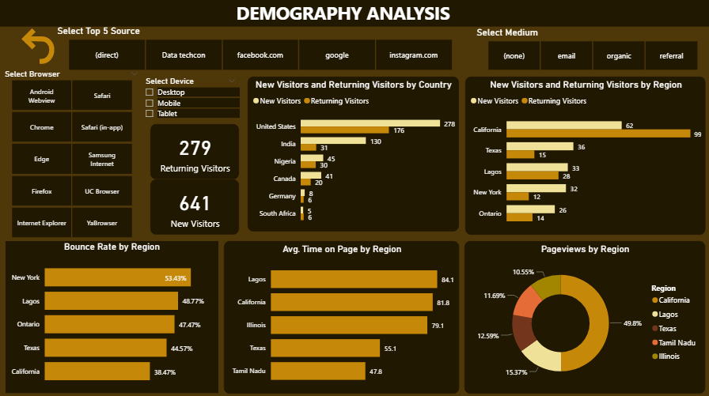

Slide 13
KEY INSIGHTS

Slide 14
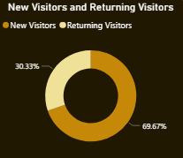
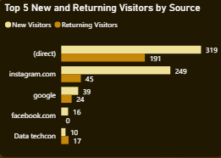
VISITORS
70 % of the visitors to the website are new users and 30 % are returning
50% & 68% of the new and returning visitors access the website directly
Direct source pulled in more traffic of visitors to the website
The returning users seems to have a good user experience visiting the website directly and they could have influenced the new users in accessing the site directly

Slide 15
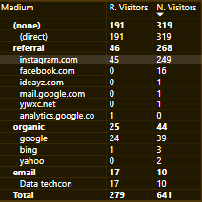
SOURCE & MEDIUM
92% of visitors that came in through referral medium used Instagram source only
Social networks like Facebook can also be exploited
88% of visitors that came in through organic search medium, employed google search only.
Search medium like yahoo and Bing can be exploited

Slide 16
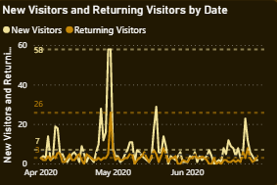
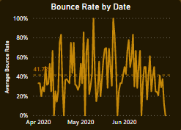
TREND
Daily average of 1% and a maximum of 9% of both visitors accessed the site daily between April 1 – June 30, 2020
Daily average of 41 % bounce rate was recorded between April 1 – June 30, 2020
Daily average of visitors appears to be too low . However, daily bounce rate of 41% is adequate to increase visitor's behavior like pageviews and conversion rate.

Slide 17
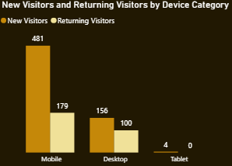
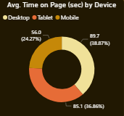
DEVICE
75% of new guests and 64% of returning accessed the website via mobile
Mobile device accounts for the lowest Avg time spent on device for 56 seconds

Slide 18
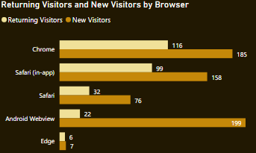
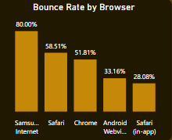
BROWSER
Chrome browser ranked highest in terms of browser used by visitors.
Highest ranked for returning users
2nd highest ranked for new users
Android WebView ranked highest for new users
Chrome and Android Webview has a bounce rate of 51.81%. and 33.16%
Website Browser compatibility issue should be resolved to further lower the bounce rate of Chrome browser.

Slide 19
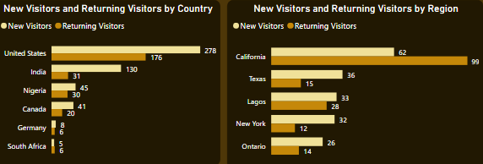
DEMOGRAPHY
US ranked highest visitors by country and accounts for 43 % and 63% of the new and returning visitors respectively
CA, TX and NY are among the top 5 region by visitors and CA is ranked the highest which accounts for 9% and 35% new and returning visitors respectively
USA seems to be the most viable market
CA, TX and NY are among the most populated states in the US and their population could be leveraged for digital marketing to drive more traffic to the website

Slide 20
RECOMMENDATION
Medium like referral on social media has shown high potential with Instagram ranking second highest in the top traffic source used by visitors. With imploding use of social media, other sources like Facebook can be leveraged to launch marketing ADS to increase traffic to the website
Every page of the website should be optimized by rich content. This would increase visibility in search engines and could be helpful in driving more traffic via organic traffic sources like google, yahoo and bing search
According to pew research center, 1/5th of Americans access the mobile web each day. Building and optimizing a mobile friendly app for good user experience could reduce the average time spent accessing via mobile and further maximize traffic greater than the 64% and 75% recorded for return and new visitors by mobile device, respectively.
The web browser compatibility issue should be resolved for mobile friendly browser like Chrome and Android Web having observed that they pulled in highest numbers with 31% and 42% of new and returning users, respectively. This would eliminate bounce rate issues like slow loading times and broken links and further drive in more traffic.

